Slide 1
Assignment 1
Name | USHA RANI. R
ZONE | 4
COLLAGE | GKM COLLAGE OF ENGINEERING AND TECHNOLOGY

Slide 2
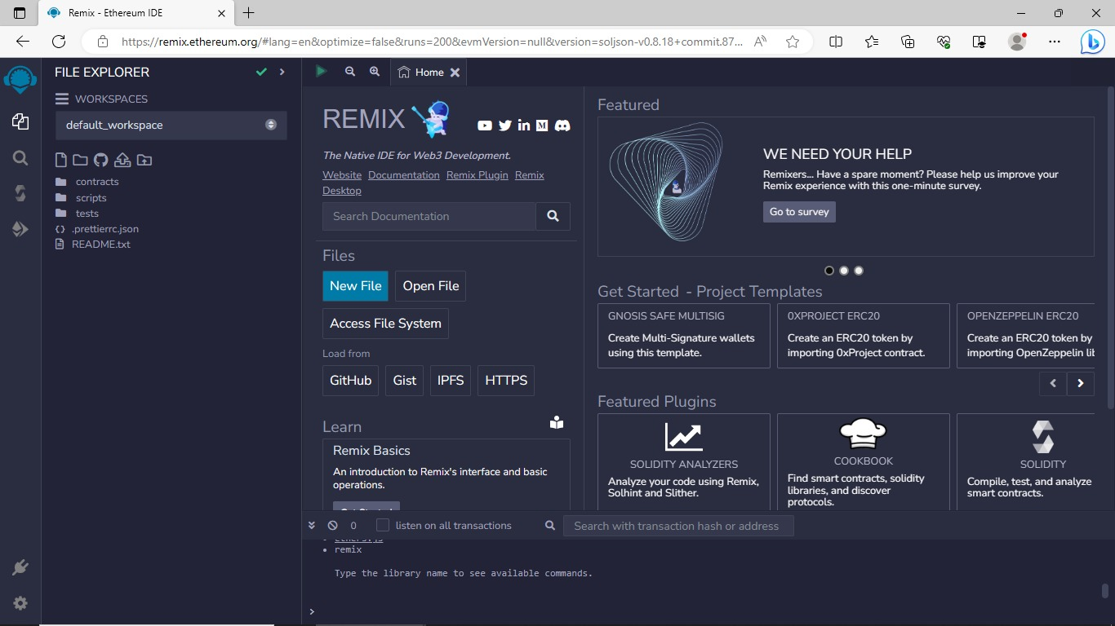
1. GO TO THE CHROME ATFORM OPEN REMIX PLATFORM

Slide 3
2. OPEN THE REMIX PAGE AND CREATE A NEW FILE

Slide 4
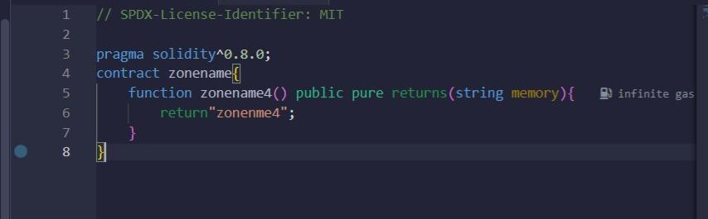
3. IN THE NEWLY CREATED FILE,CREATE A PROGRAM TO RETURN YOUR STRING ,”ZONE NAME”

Slide 5
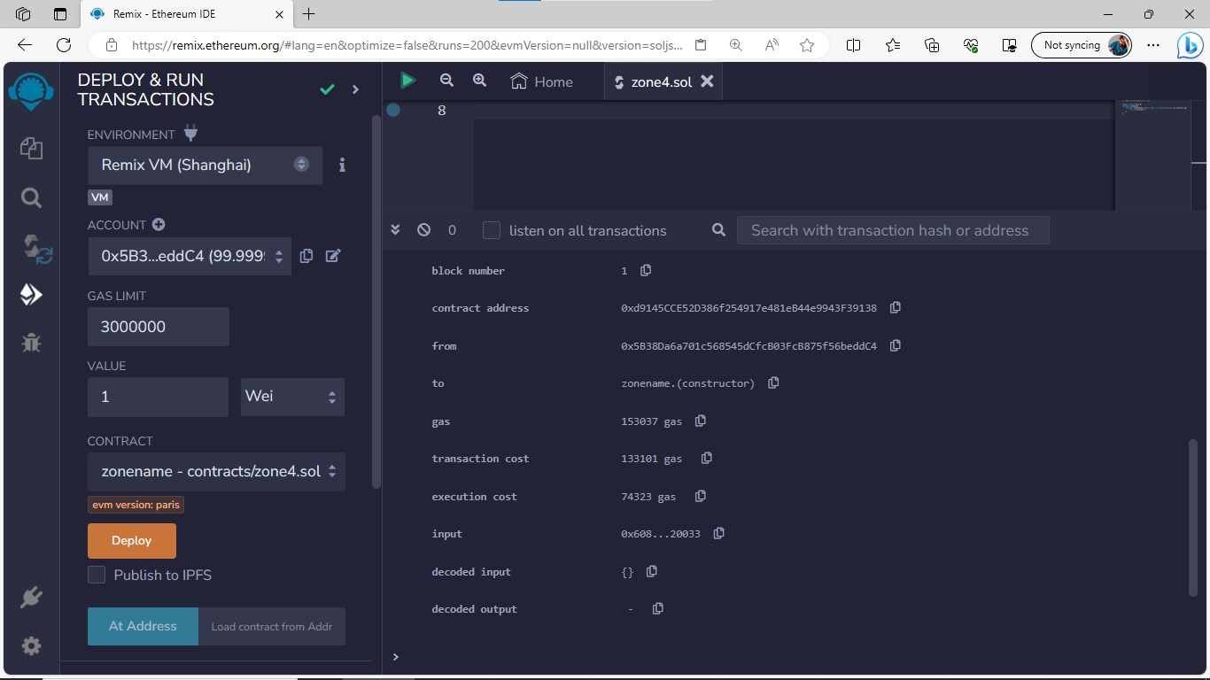

Slide 6
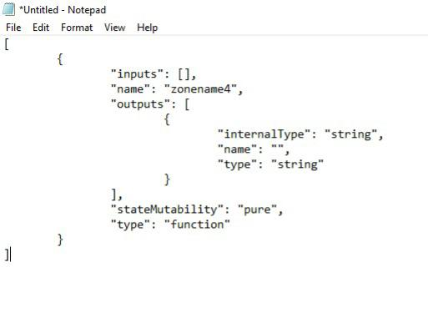
4. SAVE THE PROGRAM AND COMPILE IT TO GET THE ABI AND BYTECODE
ABI

Slide 7
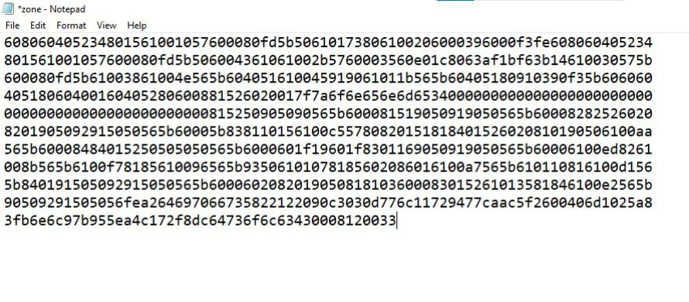
BYTECODE

Slide 8
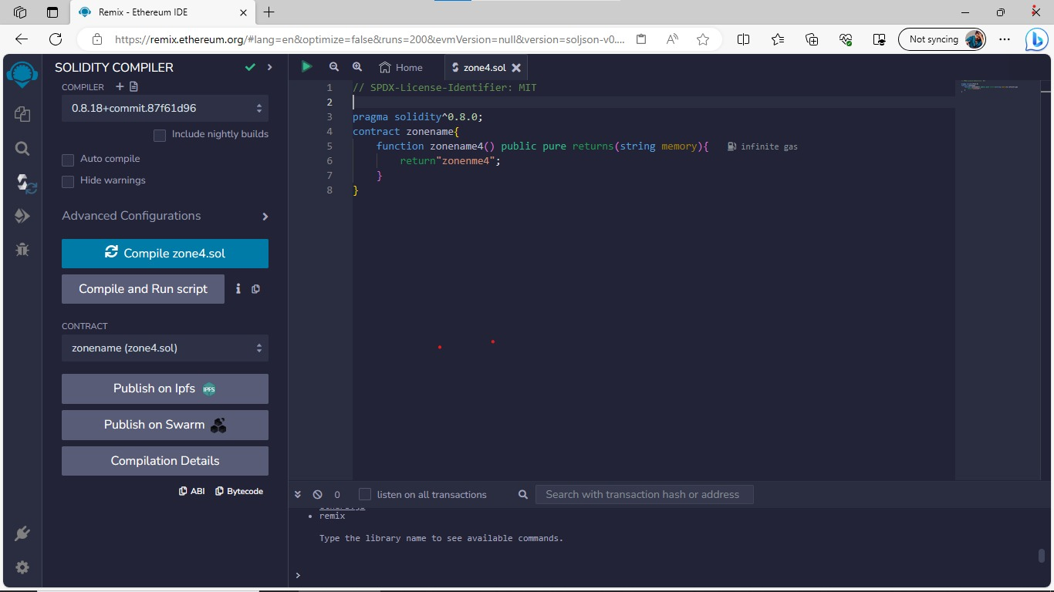
5. FINALLY DEPLOY IT TO DISPLAY THE OUTPUT

